Slide 1
ALL INDIA INSTITUTE OF MEDICAL SCIENCES
BHUBANESWAR
Know your
Central Library

Slide 2
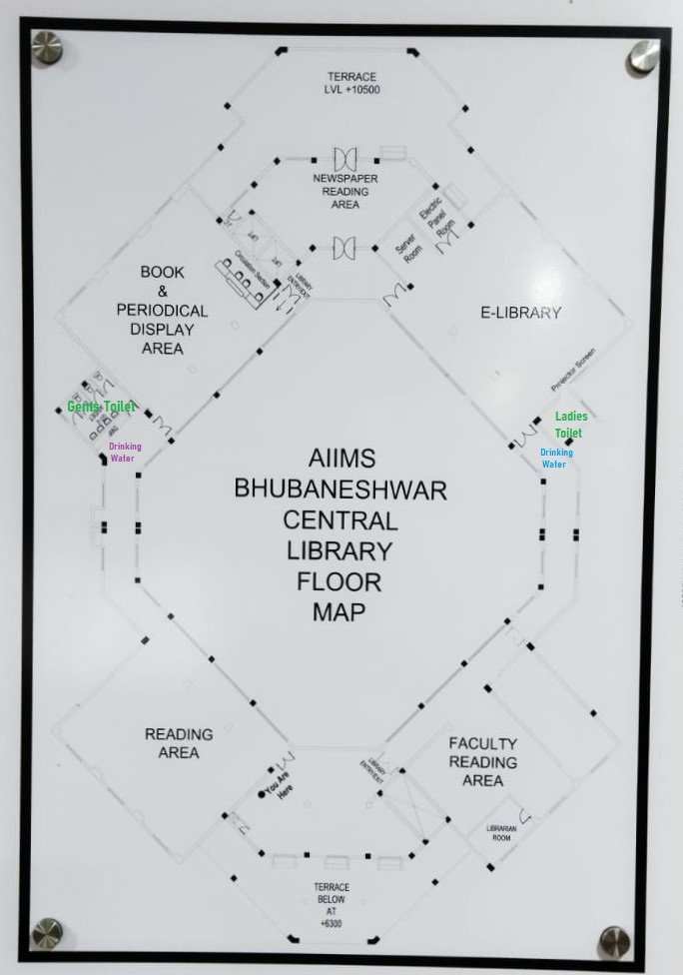

Slide 3
AGENDA
Introduction
Library Rules & Regulations
Library Resources
Library Service And Facilities
How To Get Library Resources
Future Perspective
Contact Us

Slide 4
INTRODUCTION
Central library occupies a place of pride in AIIMS, Bhubaneswar is an essential component of the institute's outstanding research and education mission. It is a most lively place on the campus providing a safe, comfortable and friendly environment that enables learning and advancement of knowledge, and promotes discovery with wi-fi facility. The main aim of the libraries is to serve the required information to the library users within a short span of time.

Slide 5
WORKING HOURS OF LIBRARY
MONDAY TO FRIDAY : 9.00 A.M. – 9.00 P.M.
SATURDAY : 9.00 A.M. – 5.00 P.M.
SUNDAY & HOLIDAYS CLOSED
READING ROOM : (24 X 7)

Slide 6
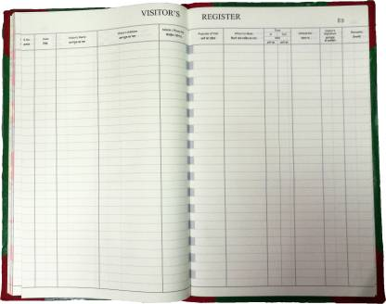
LIBRARY RULES & REGULATIONS
A Register is available at entrance of the Library. Users are requested to make their entry while entering and departing from the library.

Slide 7
LIBRARY RULES & REGULATIONS
Identity Card/ Library Card is mandatory while visiting or using the library.
Readers shall not write upon, damage, or make any mark on books, periodicals or other material belonging to the library.
Smoking, eating and drinking beverages is prohibited inside the library reading rooms and E-Library.

Slide 8
LIBRARY RULES & REGULATIONS
Late fee of Rs 5/day/book would be charged from the borrowers who retain book(s) beyond the due date.
Book may be renewed if the same is not in demand or reserve by other user. It will be done only 2 times.

Slide 9
LIBRARY RESOURCES
11000+ books in Medical, Nursing, Dental and Paramedical, Administration, Dictionary, NRHM & WHO, Odia and Hindi Languages.
21nos. Treatment Protocols.
39 nos. Bound Volumes are available.
491 nos. of CDs & DVDs are available.
243 nos. MD, MS, DM, MCh, BSc., MSc. Thesis.

Slide 10
LIBRARY RESOURCES
National & International journals are available for reference in the library.
Magazines are available in Periodical Section.
Annual Report, Insight, Arogya Sudha(Hindi) and others AIIMS Publications are available.

Slide 11
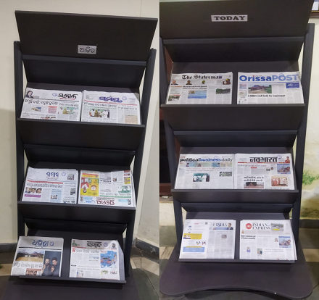
LIBRARY RESOURCES
13 Hindi, English, Odia language Newspaper are available for reading purpose.

Slide 12
ON-LINE RESOURCES AT A GLANCE
E-Databases
UpToDate
Clinical Key
BMJ Best Practice
OVID (LWW Total Collection), NEJM & JAMA Series & Medknow Journals
CINHAL
Clinical Key For Nursing
ERMED Consortium
Access Medicine
Grammarly (Online Grammar Checker)
Dspace (Institutional Repository)
Total 8 Databases , 1 Writing Tool & 1 Digital Repository

Slide 13
ON-LINE RESOURCES AT A GLANCE
E-JOURNALS | NO.
Individual Purchase | 49
Clinical Key | 706+
BMJ | 21
OVID (LWW Publication) | 290+
Medknow (Free with LWW) | 452
NEJM & JAMA Series | 11
CINHAL | 1315+
Clinical Key Nursing | 69+
ERMED (Consortium) | 242
TOTAL | 3155+

Slide 14
ON-LINE RESOURCES AT A GLANCE
E-BOOKS | NO.
Clinical Key | 997+
Access Medicine | 220+
Clinical Key Nursing | 125+
Total | 1342+

Slide 15
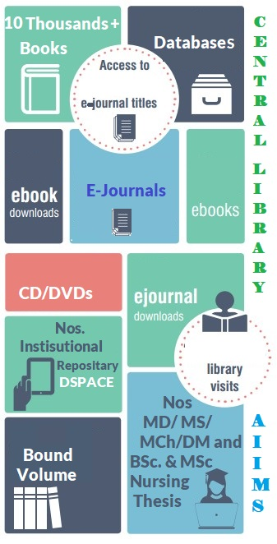
39
FACULTY Reading AREA
Eight (8)
106
General Reading
Area
3185+
322
242 ERMED
1342+
491
7000+
SITTING ARRANGEMENTS
12
Main Library
+
20
Newspaper
Area
56
E-Library
+
12
Laptop Points
1300
10,000
243
39

Slide 16
General reading room
OPENS 24X7

Slide 17
faculty reading room
OPENS 24X7

Slide 18
E-library
OPENS DURING LIBRARY WORKING HOURS

Slide 19
Book Borrowing Facilities
Users | No. of Books | No. of Days
Faculty (Med, AYUSH & Nursing) | 2 | 30 days
JR/SR(Academic) | 2 | 30 days
MSc. Nursing | 2 | 30 days
JR/SR(Non-Academic) | 2 | 15 days
MBBS | 2 | 15 days
BSc. Nursing | 2 | 15 days
BSc. Paramedical | 2 | 15 days
Hospital Staff/ Admin. Staff | 2 | 15 days
Nursing Officer | 2 | 15 days

Slide 20
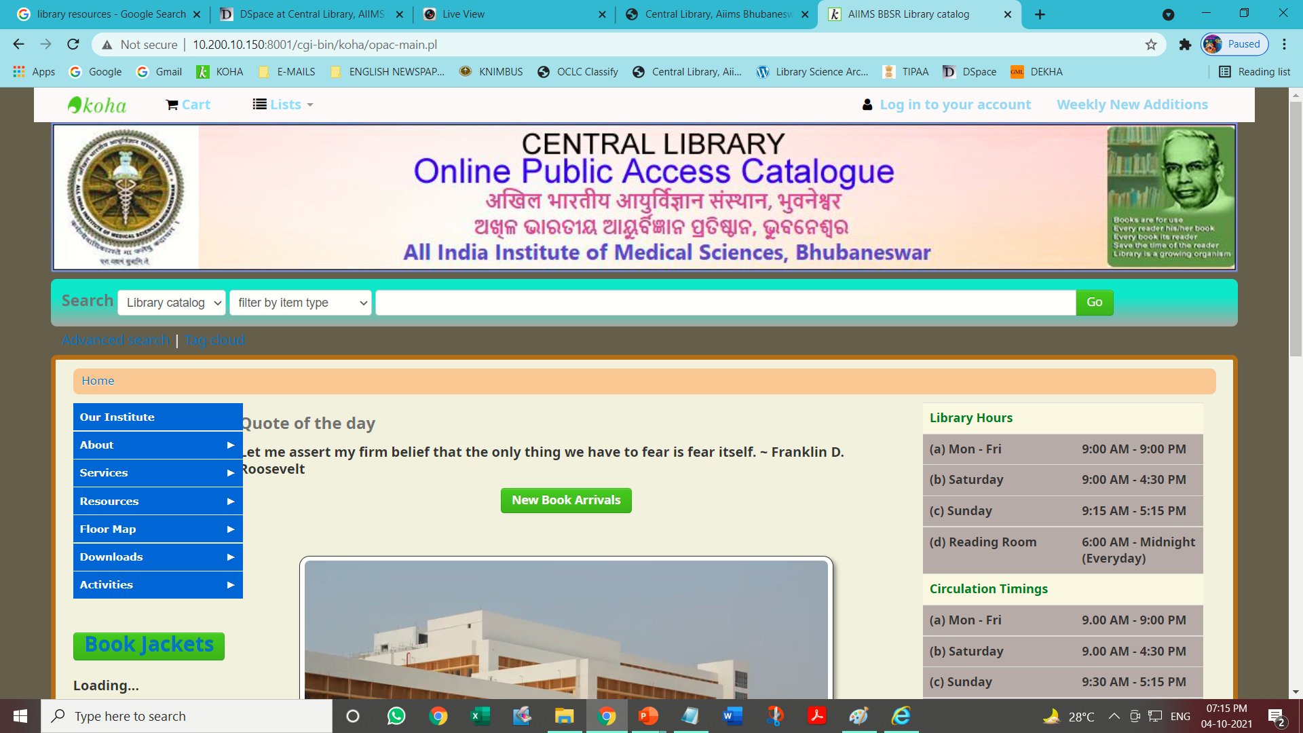
Web page of Library Catalogue
URL in our AIIMS Network http://10.200.10.150:8001/cgi-bin/koha/opac-main.pl

Slide 21
LIBRARY WEBSITE AND REMOTE ACCESS
For Access in AIIMS Network(NKN)
https://aiimsbhubaneswar.nic.in/library/
Remote Access
Access any where any time outside AIIMS network.
https://aiimsbhubaneswar.knimbus.com/user#/home

Slide 22
Library Web Page

Slide 23
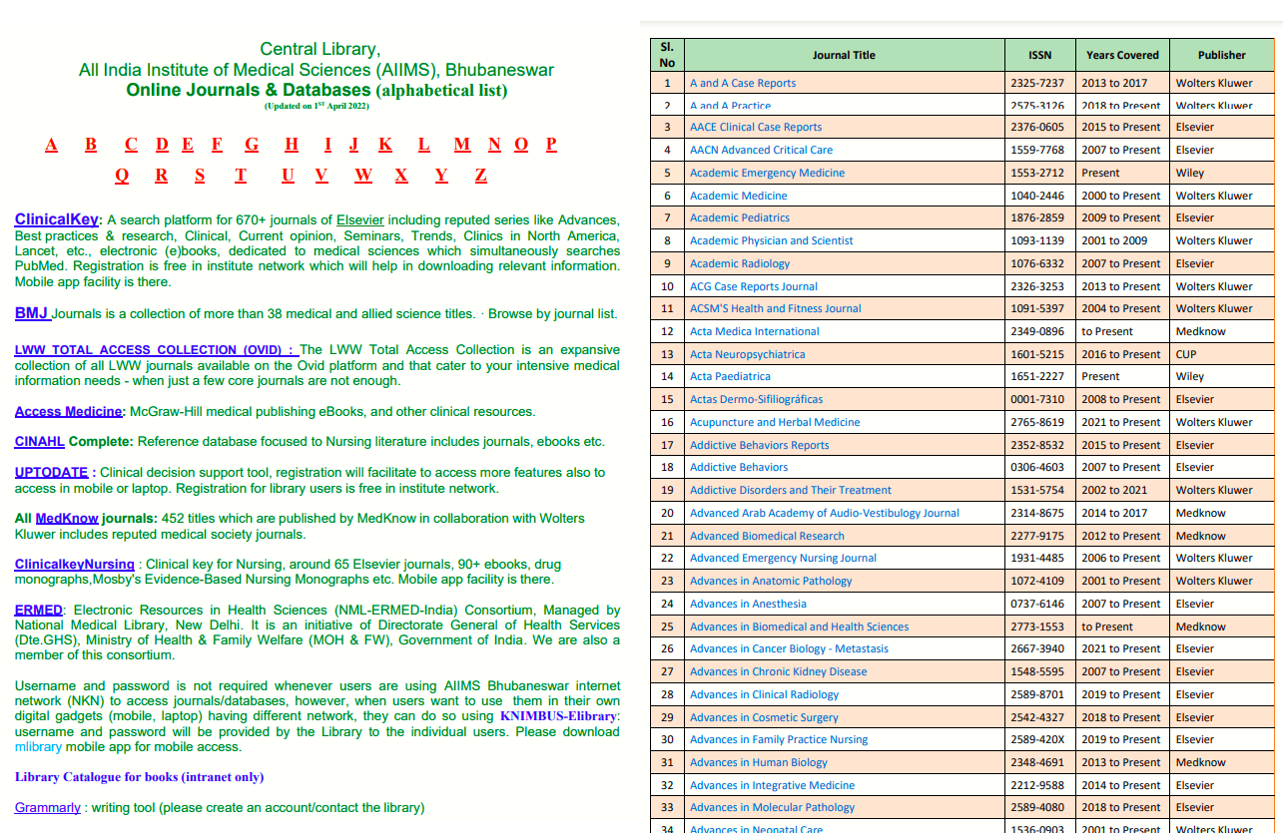
LINK TO ALL ONLINE RESOURCES

Slide 24
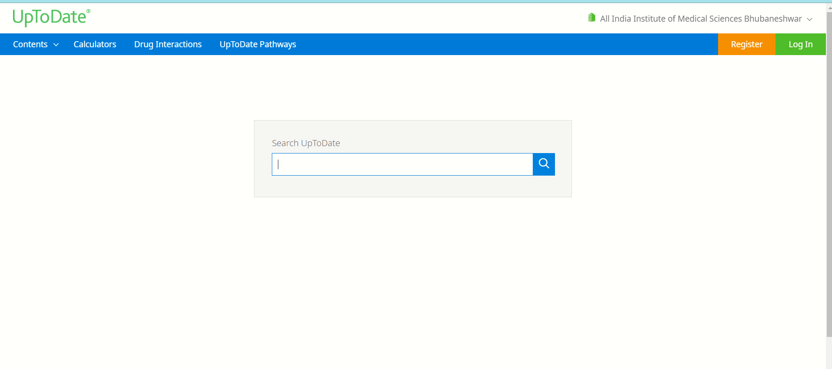
WEB INTERFACE OF UpToDate
You have to register through your e-mail id in AIIMS network
You can access through UpToDate App in your mobile, Tabs, etc.

Slide 25
WEB INTERFACE OF ClinicalKey
You have to register through your e-mail id in AIIMS network

Slide 26
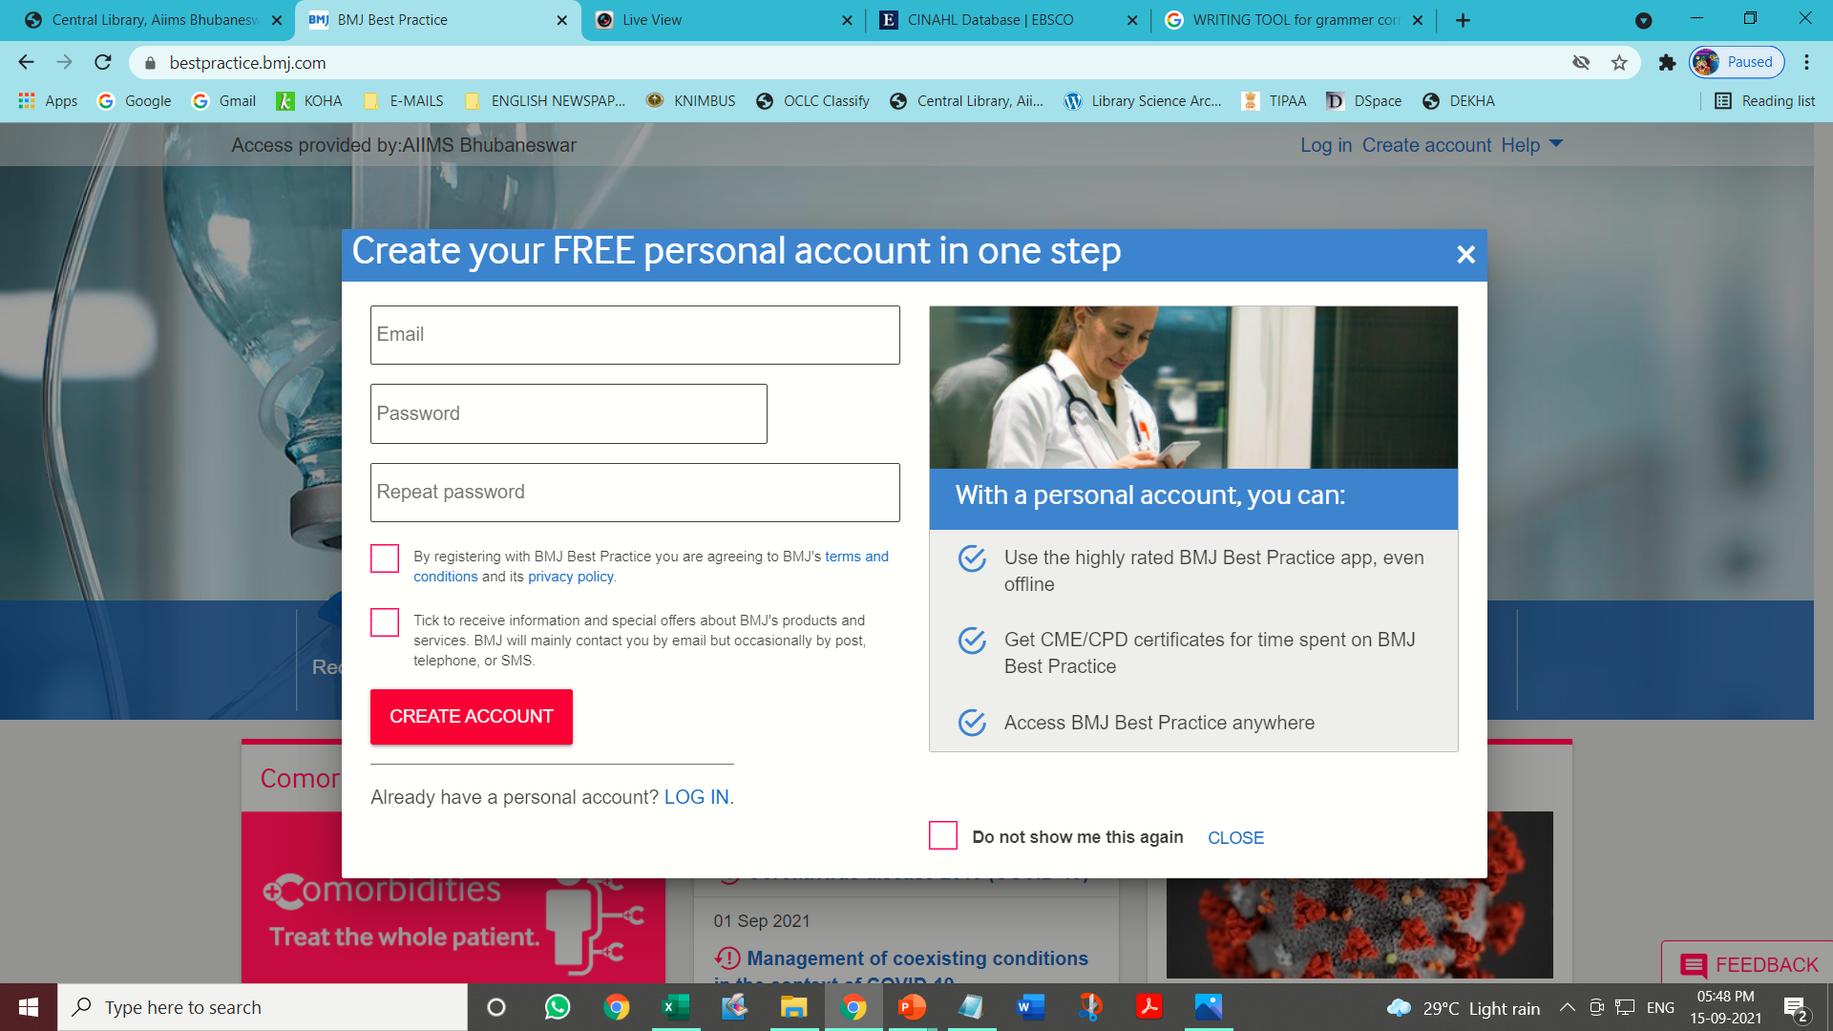
WEB INTERFACE OF BMJ BEST PRACTICE
You have to register through your e-mail id in AIIMS network

Slide 27
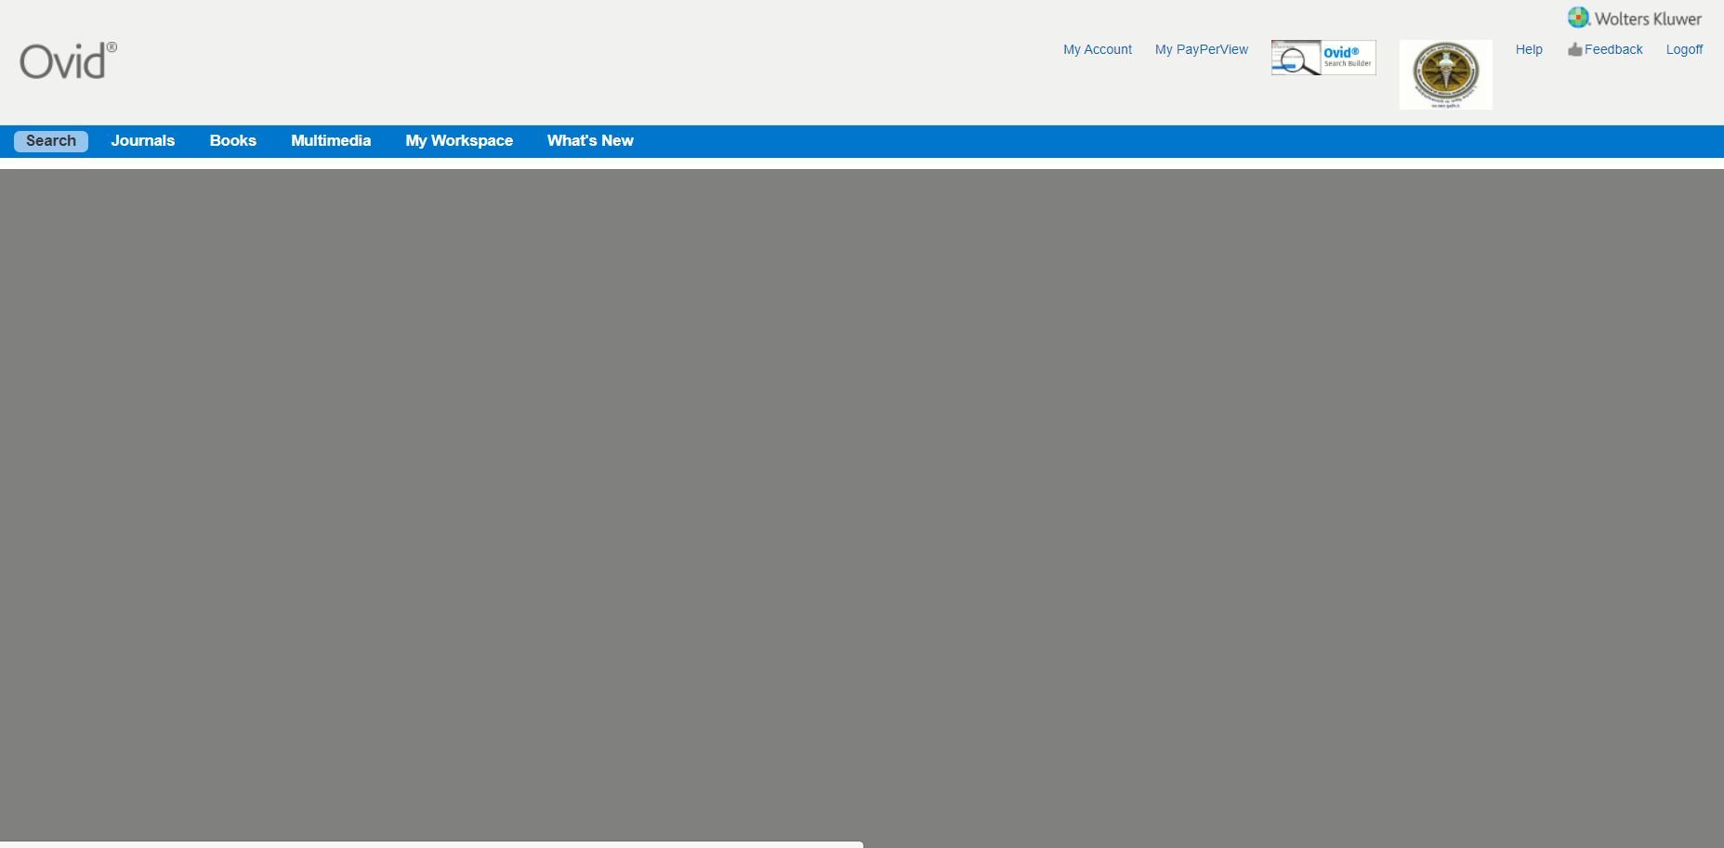
WEB INTERFACE OF OVID
You have to browse through AIIMS network

Slide 28
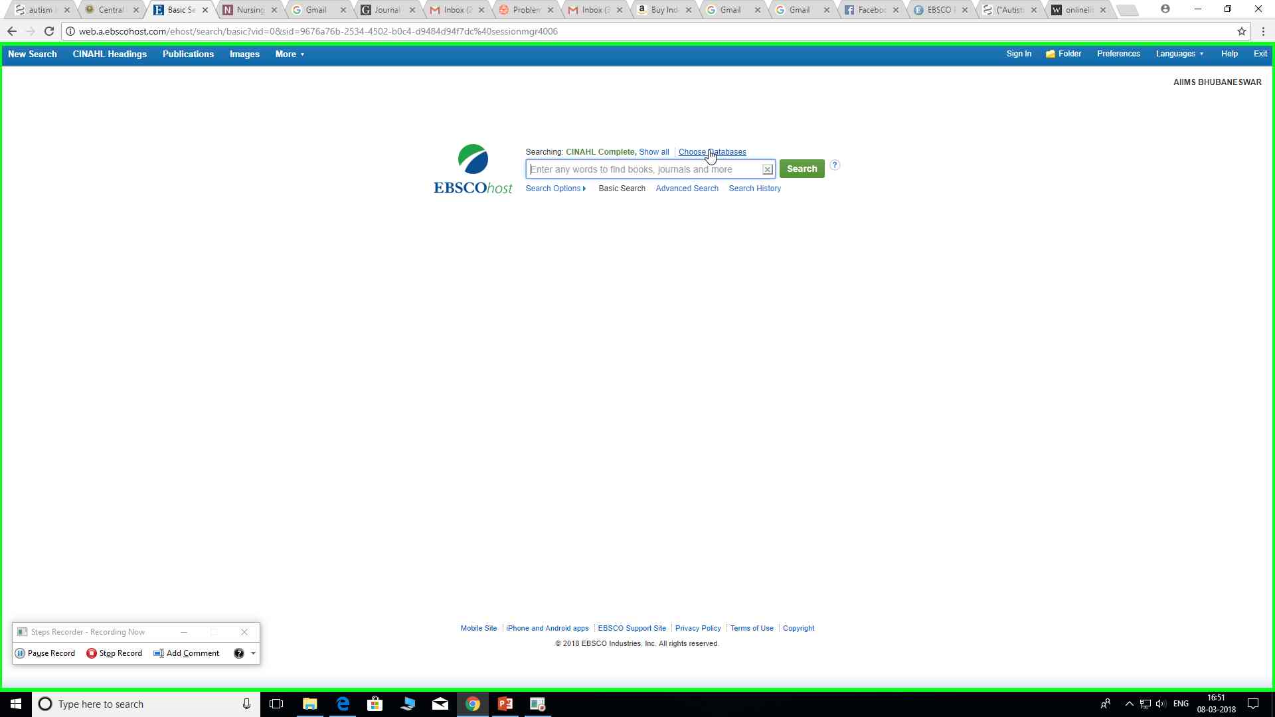
Web interface of CINAHL COMPLETE (Cumulative Index of Nursing and Allied Health)
mhtml:file:///C:/Users/AIIMS%2074/AppData/Local/Temp/Temp1_nursing.zip/Recording_20180308_1654.mht!screenshot0001.JPEG
You have to browse through AIIMS network

Slide 29
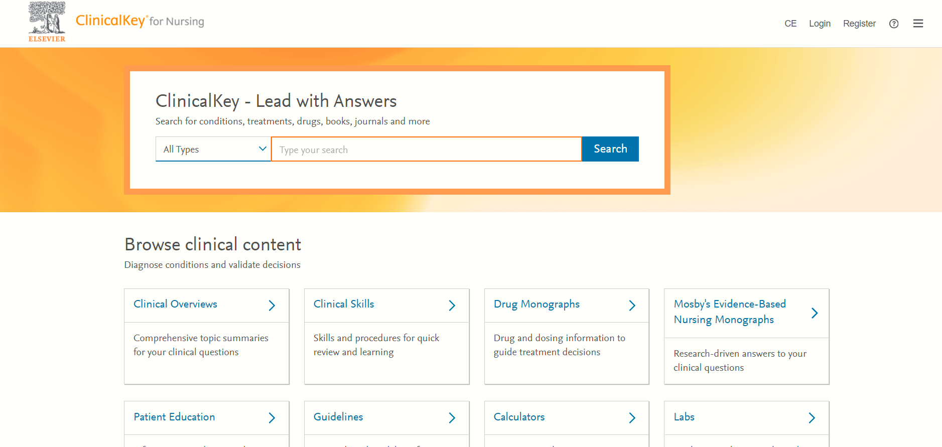
WEB INTERFACE OF Clinical Key Nursing
You have to register through your e-mail id in AIIMS network

Slide 30
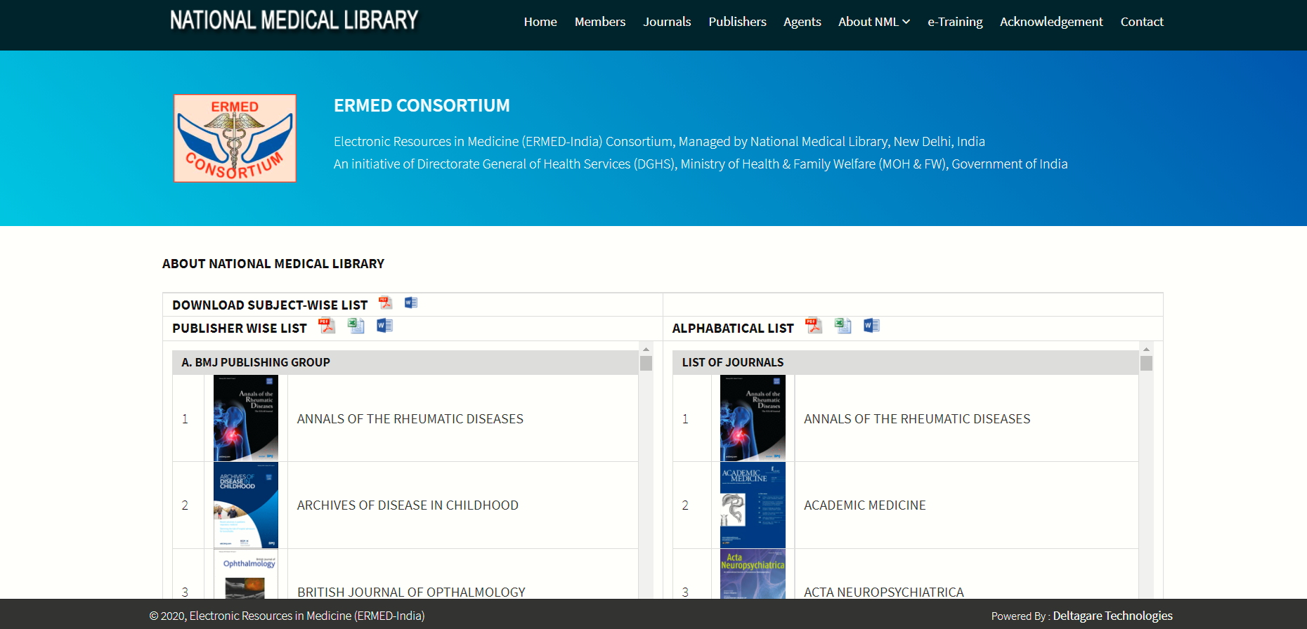
WEB INTERFACE OF ERMED
You have to browse through AIIMS network

Slide 31
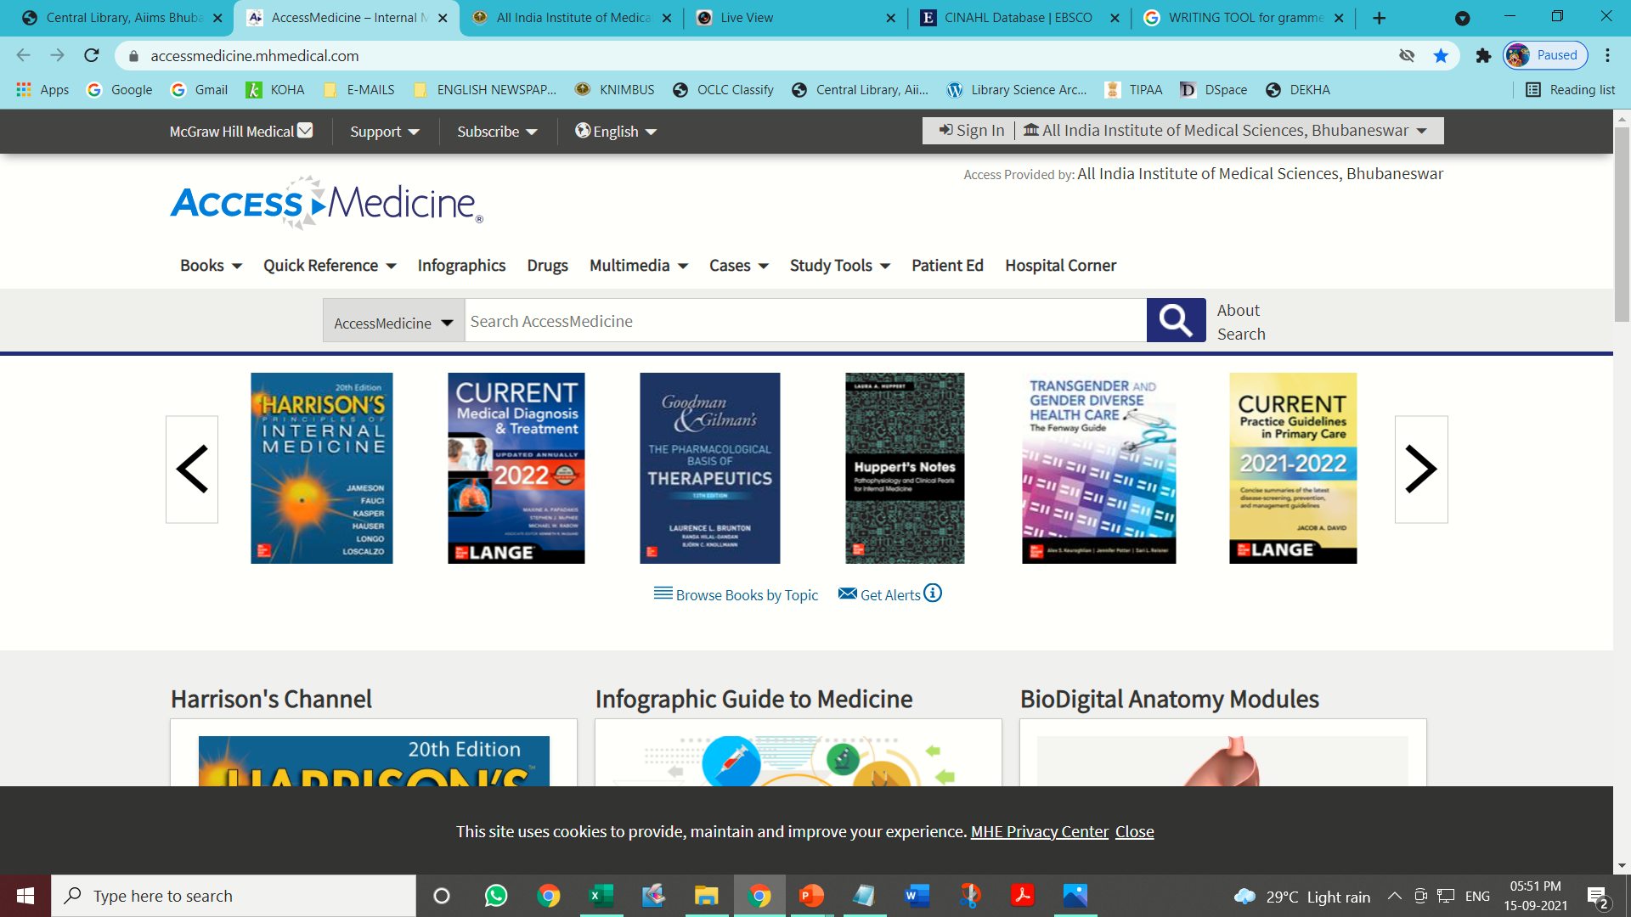
WEB INTERFACE OF ACCESS MEDICINE

Slide 32
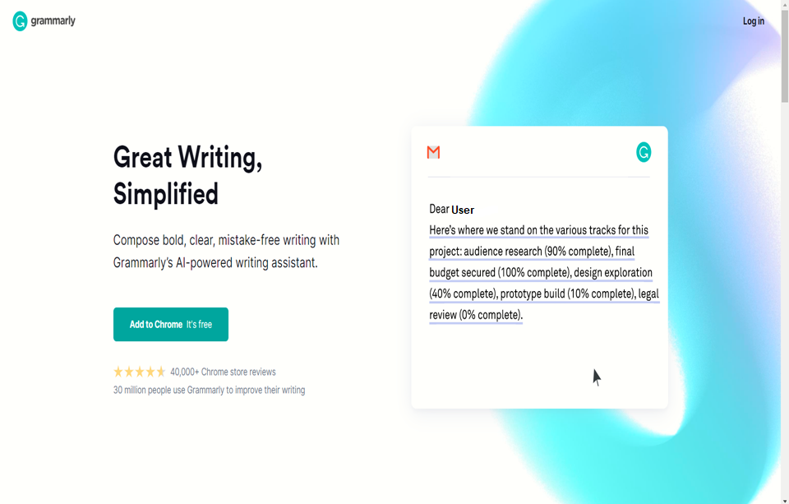
WEB INTERFACE OF GRAMMARLY

Slide 33
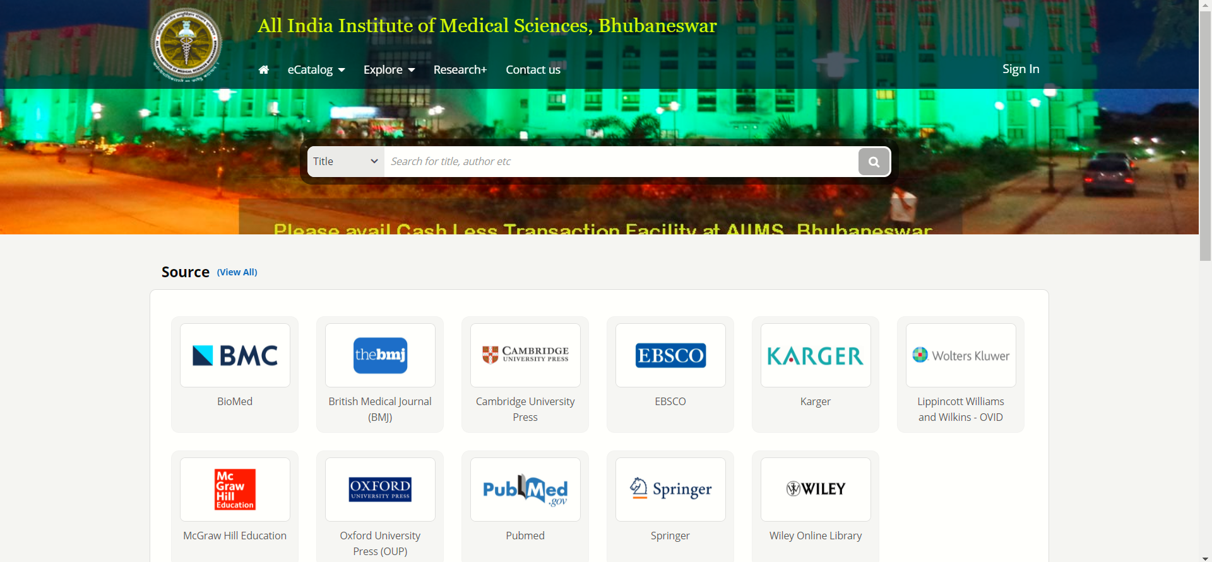
WEB INTERFACE OF REMOTE ACCESS FACILITY

Slide 34
Contact US
centrallibrary@aiimsbhubaneswar.edu.in
0674-2476900
Central Library, AIIMS, Sijua,
Dumuduma, Bhubaneswar, Odisha, 751019

